Slide 1
Cryptography and Network Security
Chapter 6
Fifth Edition
by William Stallings
Lecture slides by Lawrie Brown
Notes:
Lecture slides by Lawrie Brown for “Cryptography and Network Security”, 5/e, by William Stallings, Chapter 6 – “Block Cipher Operation”.

Slide 2
Chapter 6 – Block Cipher Operation
Many savages at the present day regard their names as vital parts of themselves, and therefore take great pains to conceal their real names, lest these should give to evil-disposed persons a handle by which to injure their owners.
— The Golden Bough, Sir James George Frazer
Notes:
Opening quote.

Slide 3
Multiple Encryption & DES
clear a replacement for DES was needed
  theoretical attacks that can break it
  demonstrated exhaustive key search attacks
AES is a new cipher alternative
prior to this alternative was to use multiple encryption with DES implementations
Triple-DES is the chosen form
Notes:
Given the potential vulnerability of DES to a brute-force attack,there has been considerable interest in finding an alternative. One approach is to design a completely new algorithm, of which AES is a prime example. Another alternative, which would preserve the existing investment in software and equipment, is to use multiple encryption with DES and multiple keys. We examine the widely accepted triple DES (3DES) approach.

Slide 4

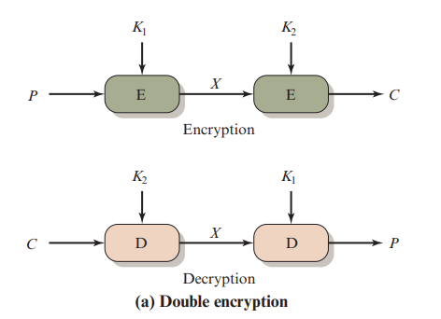
Why not Double-DES?

Slide 5
Why not Double-DES?
could use 2 DES encrypts on each block
  C = E_{K2}(E_{K1}(P))
concern at time of reduction to single stage
“meet-in-the-middle” attack
  works whenever use a cipher twice
  since X = E_{K1}(P) = D_{K2}(C)
  attack by encrypting P with all keys and store
  then decrypt C with keys and match X value
  can show takes O(2⁵⁶) steps
  Requires…
known plaintext
Notes:
The simplest form of multiple encryption has two encryption stages and two keys - Double-DES.
Have concern that there might be a single key that is equivalent to using 2 keys as above, not likely but only finally proved as impossible in 1992.
More seriously have the “meet-in-the-middle” attack, first described by Diffie in 1977. It is a known plaintext attack (ie have know pair (P,C), and attempts to find by trial-and-error a value X in the “middle” of the double-DES encryption of this pair, and chances of this are much better at O(2^56) than exhaustive search at O(2^112).

Slide 6
Triple-DES with Two-Keys
hence must use 3 encryptions
  would seem to need 3 distinct keys
but can use 2 keys with E-D-E sequence
  C = E_{K1}(D_{K2}(E_{K1}(P)))
  n.b. encrypt & decrypt equivalent in security
  if K1=K2 then can work with single DES
standardized in ANSI X9.17 & ISO8732
no current known practical attacks
  several proposed impractical attacks might become basis of future attacks
Notes:
Triple-DES with two keys is a popular alternative to single-DES, but suffers from being 3 times slower to run. The use of encryption & decryption stages are equivalent, but the chosen structure allows for compatibility with single-DES implementations. 3DES with two keys is a relatively popular alternative to DES and has been adopted for use in the key management standards ANS X9.17 and ISO 8732. Currently, there are no practical cryptanalytic attacks on 3DES. Coppersmith notes that the cost of a brute-force key search on 3DES is on the order of 2^112 (=5*10^33) and estimates that the cost of differential cryptanalysis suffers an exponential growth, compared to single DES, exceeding 10^52.
There are several proposed attacks on 3DES that, although not currently practical, give a flavor for the types of attacks that have been considered and that could form the basis for more successful future attacks. See text for details.

Slide 7
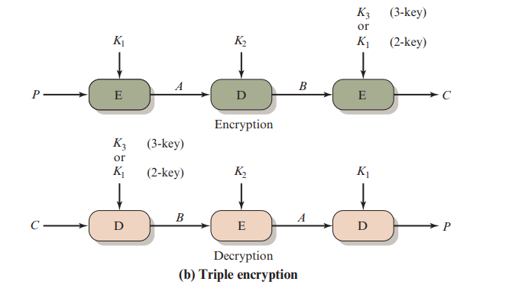
Triple-DES with Two-Keys
Notes:
Triple-DES with two keys is a popular alternative to single-DES, but suffers from being 3 times slower to run. The use of encryption & decryption stages are equivalent, but the chosen structure allows for compatibility with single-DES implementations. 3DES with two keys is a relatively popular alternative to DES and has been adopted for use in the key management standards ANS X9.17 and ISO 8732. Currently, there are no practical cryptanalytic attacks on 3DES. Coppersmith notes that the cost of a brute-force key search on 3DES is on the order of 2^112 (=5*10^33) and estimates that the cost of differential cryptanalysis suffers an exponential growth, compared to single DES, exceeding 10^52.
There are several proposed attacks on 3DES that, although not currently practical, give a flavor for the types of attacks that have been considered and that could form the basis for more successful future attacks. See text for details.

Slide 8
Triple-DES with Three-Keys
although are no practical attacks on two-key Triple-DES have some indications
can use Triple-DES with Three-Keys to avoid even these
  C = E_{K3}(D_{K2}(E_{K1}(P)))
has been adopted by some Internet applications, e.g., PGP, S/MIME
Notes:
Although the attacks currently known appear impractical, anyone using two-key 3DES may feel some concern. Thus, many researchers now feel that three-key 3DES is the preferred alternative. Three-key 3DES has an effective key length of 168 bits and is defined as shown. A number of Internet-based applications have adopted three-key 3DES, including PGP and S/MIME.

Slide 9
Modes of Operation
block ciphers encrypt fixed size blocks
  e.g., DES encrypts 64-bit blocks
need some way to en/decrypt arbitrary amounts of data in practice
NIST SP 800-38A defines 5 modes
have block and stream modes
to cover a wide variety of applications
can be used with any block cipher
Notes:
DES (or any block cipher) forms a basic building block, which en/decrypts a fixed sized block of data. However to use these in practise, we usually need to handle arbitrary amounts of data, which may be available in advance (in which case a block mode is appropriate), and may only be available a bit/byte at a time (in which case a stream mode is used). To apply a block cipher in a variety of applications, five "modes of operation" have been defined by NIST (SP 800-38A). In essence, a mode of operation is a technique for enhancing the effect of a cryptographic algorithm or adapting the algorithm for an application, such as applying a block cipher to a sequence of data blocks or a data stream. The five modes are intended to cover a wide variety of applications of encryption for which a block cipher could be used. These modes are intended for use with any symmetric block cipher, including triple DES and AES. .

Slide 10
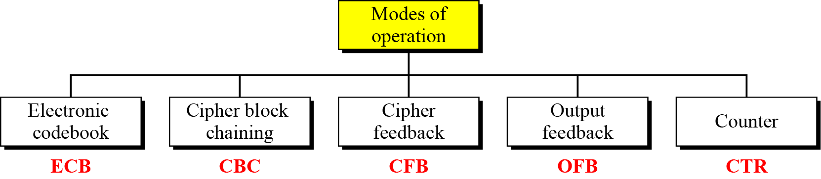
Modes of Operation

Slide 11
Modes of Operation
Initialize Vector (IV)
  a block of bits to randomize the encryption and hence to produce distinct ciphertext
Nonce : Number (used) Once
  Random of psuedorandom number to ensure that past communications can not be reused in replay attacks
  Some also refer to initialize vector as nonce
Padding
  final block may require a padding to fit a block size
  Method
    Add null Bytes
    Add 0x80 and many 0x00
    Add the n bytes with value n

Slide 12
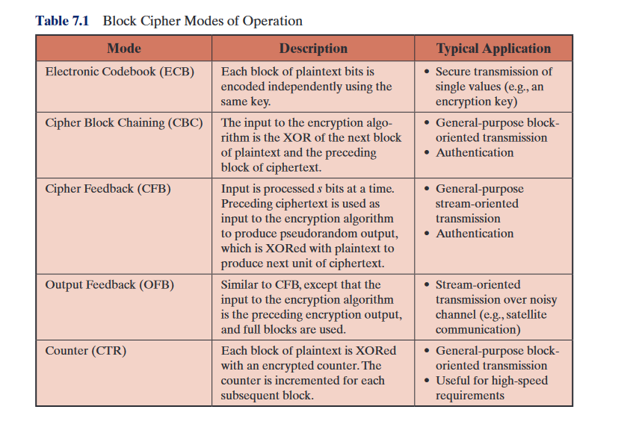



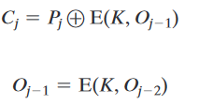
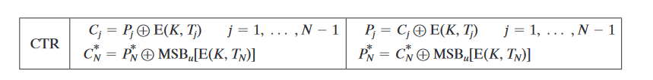
Modes of Operation

Slide 13
Electronic Codebook Book (ECB)
message is broken into independent blocks that are encrypted
each block is a value which is substituted, like a codebook, hence name
each block is encoded independently of the other blocks
  C_{i} = E_{K}(P_{i})
uses: secure transmission of single values
Notes:
The simplest mode is the electronic codebook (ECB) mode, in which plaintext is handled one block at a time and each block of plaintext is encrypted using the same key. The term codebook is used because, for a given key, there is a unique ciphertext for every b-bit block of plaintext. Therefore, we can imagine a gigantic codebook in which there is an entry for every possible b-bit plaintext pattern showing its corresponding ciphertext. For a message longer than b bits, the procedure is simply to break the message into b-bit blocks, padding the last block if necessary. Decryption is performed one block at a time, always using the same key. ECB is the simplest of the modes, and is used when only a single block of info needs to be sent (eg. a session key encrypted using a master key).

Slide 14
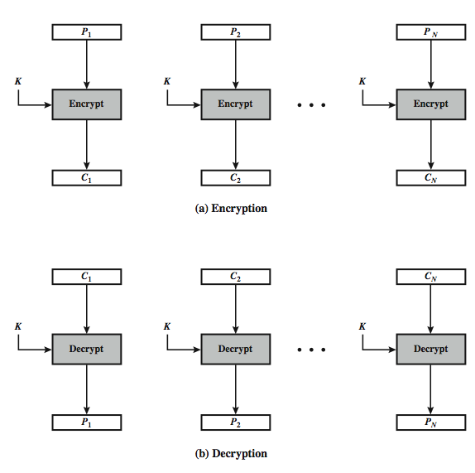
Electronic Codebook Book (ECB)
Notes:
Stallings Figure 6.3 illustrates the Electronic Codebook (ECB) Mode.

Slide 15
Advantages and Limitations of ECB
message repetitions may show in ciphertext
  if aligned with message block
  particularly with data such graphics
  or with messages that change very little, which become a code-book analysis problem
weakness is due to the encrypted message blocks being independent
vulnerable to cut-and-paste attacks
main use is sending a few blocks of data
Notes:
For lengthy messages, the ECB mode may not be secure. If the message is highly structured, it may be possible for a cryptanalyst to exploit these regularities. If the message has repetitive elements, with a period of repetition a multiple of b bits, then these elements can be identified by the analyst. This may help in the analysis or may provide an opportunity for substituting or rearranging blocks. Hence ECB is not appropriate for any quantity of data, since repetitions can be seen, esp. with graphics, and because the blocks can be shuffled/inserted without affecting the en/decryption of each block. Its main use is to send one or a very few blocks, eg a session encryption key.

Slide 16
Cipher Block Chaining (CBC)
message is broken into blocks
linked together in encryption operation
each previous cipher block is chained with current plaintext block, hence name
use Initial Vector (IV) to start process
  C_{i} = E_{K}(P_{i} XOR C_{i-1})
  C₋₁ = IV
IV prevents same P from making same C
uses: bulk data encryption, authentication
Notes:
To overcome the problems of repetitions and order independence in ECB, want some way of making the ciphertext dependent on all blocks before it. The CBC provides this, by combining the previous ciphertext block with the current message block before encrypting. In effect, we have chained together the processing of the sequence of plaintext blocks. The input to the encryption function for each plaintext block bears no fixed relationship to the plaintext block. Therefore, repeating patterns of b bits are not exposed. For decryption, each cipher block is passed through the decryption algorithm. The result is XORed with the preceding ciphertext block to produce the plaintext block. To produce the first block of ciphertext, an initialization vector (IV) is XORed with the first block of plaintext. On decryption, the IV is XORed with the output of the decryption algorithm to recover the first block of plaintext. The IV is a data block that is that same size as the cipher block, and is either well known (often all 0's), or otherwise is sent, ECB encrypted, just before starting CBC use. CBC mode is applicable whenever large amounts of data need to be sent securely, provided that all data is available in advance (eg email, FTP, web etc).

Slide 17
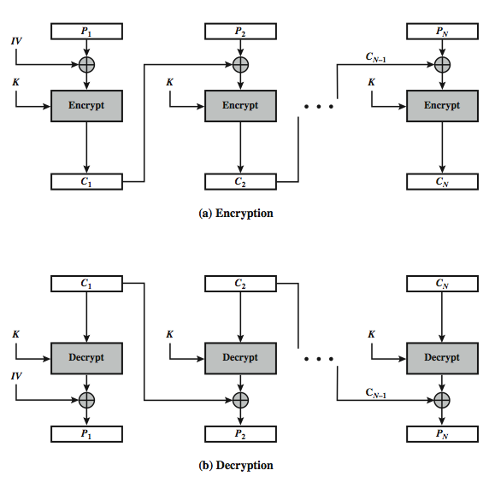
Cipher Block Chaining (CBC)
Notes:
Stallings Figure 6.4 illustrates the Cipher Block Chaining (CBC) Mode.

Slide 18
Message Padding
at end of message must handle a possible last short block
  which is not as large as blocksize of cipher
  pad either with known non-data value
    e.g., nulls
  or pad last block along with count of pad size
    e.g., [ b1 b2 b3 0 0 0 0 5]
    means have 3 data bytes, then 5 bytes pad+count
  this may require an extra entire block over those in message
there are other, more esoteric modes, which avoid the need for an extra block
Notes:
One issue that arises with block modes is how to handle the last block, which may well not be complete. In general have to pad this block (typically with 0's), and then must recognise padding at other end - may be obvious (eg in text the 0 value should usually not occur), or otherwise must explicitly have the last byte as a count of how much padding was used (including the count). Note that if this is done, if the last block IS an even multiple of 8 bytes or has exactly the same form as pad+count, then will have to add an extra block, all padding so as to have a count in the last byte. There are other, more esoteric, “ciphertext stealing” modes, which avoid the need for an extra block.

Slide 19
Advantages and Limitations of CBC
a ciphertext block depends on all blocks before it
any change to a block affects all following ciphertext blocks...
need Initialization Vector (IV)
  which must be known to sender & receiver
  if sent in clear, attacker can change bits of first block, by changing corresponding bits of IV
  hence IV must either be a fixed value (as in EFTPOS)
  or derived in way hard to manipulate
  or sent encrypted in ECB mode before rest of message
  or message integrity must be checked otherwise
avalanche effect
Notes:
CBC is the block mode generally used. The chaining provides an avalanche effect, which means the encrypted message cannot be changed or rearranged without totally destroying the subsequent data. However there is the issue of ensuring that the IV is either fixed or sent encrypted in ECB mode to stop attacks on 1st block.

Slide 20
Stream Modes of Operation
block modes encrypt entire block
may need to operate on smaller units
  real time data
convert block cipher into stream cipher
  cipher feedback (CFB) mode
  output feedback (OFB) mode
  counter (CTR) mode
use block cipher as some form of pseudo-random number generator...
Vernam cipher
Notes:
For AES, DES, or any block cipher, encryption is performed on a block of b bits. However, it is possible to convert a block cipher into a stream cipher, using one of the three modes to be discussed in this and the next two sections: cipher feedback (CFB) mode, output feedback (OFB) mode, and counter (CTR) mode. A stream cipher eliminates the need to pad a message to be an integral number of blocks. It also can operate in real time. Thus, if a character stream is being transmitted, each character can be encrypted and transmitted immediately using a character-oriented stream cipher. Idea here is to use the block cipher essentially as a pseudo-random number, and to combine these "random" bits with the message. One desirable property of a stream cipher is that the ciphertext be of the same length as the plaintext. Thus, if 8-bit characters are being transmitted, each character should be encrypted to produce a ciphertext output of 8 bits. If more than 8 bits are produced, transmission capacity is wasted.

Slide 21
Cipher FeedBack (CFB)
message is treated as a stream of bits
added to the output of the block cipher
result is feed back for next stage (hence name)
standard allows any number of bits (1,8, 64 or 128 etc) to be feed back
  denoted CFB-1, CFB-8, CFB-64, CFB-128, etc.
most efficient to use all bits in block (64 or 128)
  C_{i} = P_{i} XOR E_{K}(C_{i-1})
  C₋₁ = IV
uses: stream data encryption, authentication
Notes:
Cipher feedback (CFB) mode is one alternative. As with CBC, the units of plaintext are chained together, so that the ciphertext of any plaintext unit is a function of all the preceding plaintext. In this case, rather than units of b bits, the plaintext is divided into segments of s bits. The input to the encryption function is a b-bit shift register that is initially set to some initialization vector (IV). The leftmost (most significant) s bits of the output of the encryption function are XORed with the first segment of plaintext P1 to produce the first unit of ciphertext C1, which is then transmitted. In addition, the contents of the shift register are shifted left by s bits and C1 is placed in the rightmost (least significant) s bits of the shift register. This process continues until all plaintext units have been encrypted. For decryption, the same scheme is used, except that the received ciphertext unit is XORed with the output of the encryption function to produce the plaintext unit. Note that it is the encryption function that is used, not the decryption function.
As originally defined, CFB was to "consume" as much of the "random" output as needed for each message unit (bit/byte) before "bumping" bits out of the buffer and re-encrypting. This is wasteful though, and slows the encryption down as more encryptions are needed. An alternate way to think of it is to generate a block of "random" bits, consume them as message bits/bytes arrive, and when they're used up, only then feed a full block of ciphertext back. This is CFB-64 or CFB-128 mode (depending on the block size of the cipher used eg DES or AES respectively). CFB is the usual choice for quantities of stream oriented data, and for authentication use.

Slide 22
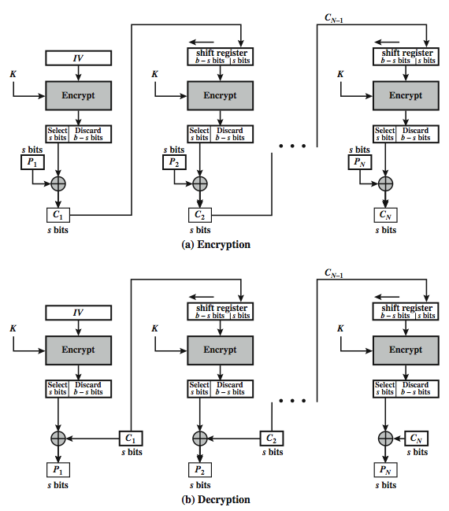
s-bit
Cipher FeedBack (CFB-s)
Notes:
Stallings Figure 6.5 illustrates the operation of s-bit Cipher FeedBack (CFB) Mode.

Slide 23
Advantages and Limitations of CFB
most common stream mode
appropriate when data arrives in bits/bytes
limitation is need to stall while do block encryption after every s-bits
note that the block cipher is used in encryption mode at both ends (XOR)
errors propagate for several blocks after the error
... how many?
Notes:
CFB is the usual stream mode. As long as can keep up with the input, doing encryptions every 8 bytes. A possible problem is that if its used over a "noisy" link, then any corrupted bit will destroy values in the current and next blocks (since the current block feeds as input to create the random bits for the next). So either must use over a reliable network transport layer (typical) or use OFB/CTR.

Slide 24
Output FeedBack (OFB)
message is treated as a stream of bits
output of cipher is added to message
output is then feed back (hence name)
  O_{i} = E_{K}(O_{i-1})
  C_{i} = P_{i} XOR O_{i}
  O₋₁ = IV
feedback is independent of message
can be computed in advance
uses: stream encryption on noisy channels
Why noisy channels?
Notes:
An alternative to CFB is OFB. Here the generation of the "random" bits is independent of the message being encrypted. The output feedback (OFB) mode is similar in structure to that of CFB, except that the output of the encryption function is fed back to the shift register in OFB, whereas in CFB the ciphertext unit is fed back to the shift register. The other difference is that the OFB mode operates on full blocks of plaintext and ciphertext, not on an s-bit subset. The advantage is that firstly, they can be computed in advance, which is good for bursty traffic, and secondly, any bit error only affects a single bit. Thus this is good for noisy links (eg satellite TV transmissions etc).

Slide 25
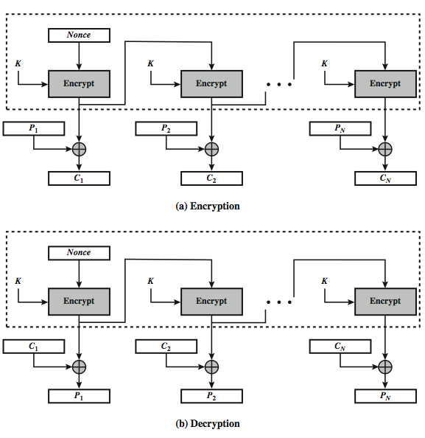
Output FeedBack (OFB)
Notes:
Stallings Figure 6.6 illustrates the Output FeedBack (OFB) Mode.

Slide 26
Advantages and Limitations of OFB
needs an IV which is unique for each use
  if ever reuse attacker can recover outputs...
  OTP
can pre-compute
bit errors do not propagate
more vulnerable to message stream modification...
  change arbitrary bits by changing ciphertext
sender & receiver must remain in sync
only use with full block feedback
  subsequent research has shown that only full block feedback (ie CFB-64 or CFB-128) should ever be used
Notes:
As with CBC and CFB, the OFB mode requires an initialization vector. In the case of OFB, the IV must be a nonce; that is, the IV must be unique to each execution of the encryption operation. The reason for this is that the sequence of encryption output blocks, Oi. , depends only on the key and the IV, and does not depend on the plaintext. Therefore, for a given key and IV, the stream of output bits used to XOR with the stream of plaintext bits is fixed. If two different messages had an identical block of plaintext in the identical position, then an attacker would be able to determine that portion of the O stream.
One advantage of the OFB method is that bit errors in transmission do not propagate. The disadvantage of OFB is that it is more vulnerable to a message stream modification attack than is CFB.
OFB has the structure of a typical stream cipher, in that the cipher generates a stream of bits as a function of an initial value and a key, and that stream of bits is XORed with the plaintext bits. Hence the sender & receiver need to remain in sync, or all data is lost. Also, research has shown that you should only ever use a full block feedback ie OFB-64/128 mode. Hence OFB encrypts plaintext a full block at a time, where typically a block is 64 or 128 bits.

Slide 27
Counter (CTR)
a “new” mode, though proposed early on
similar to OFB but encrypts counter value rather than any feedback value
  O_{i} = E_{K}(i)
  C_{i} = P_{i} XOR O_{i}
must have a different key & counter value for every plaintext block (never reused)
  again, OTP issue
uses: high-speed network encryptions
Notes:
The Counter (CTR) mode is a variant of OFB, but which encrypts a counter value (hence name). Although it was proposed many years before, it has only recently been standardized for use with AES along with the other existing 4 modes. It is being used with applications in ATM (asynchronous transfer mode) network security and IPSec (IP security). A counter, equal to the plaintext block size is used. The only requirement stated in SP 800-38A is that the counter value must be different for each plaintext block that is encrypted. Typically the counter is initialized to some value and then incremented by 1 for each subsequent block. As with the OFB mode, the initial counter value must be a nonce; be different for all of the messages encrypted using the same key. Further, all counter values across all messages must be unique. If, contrary to this requirement, a counter value is used multiple times, then the confidentiality of all of the plaintext blocks corresponding to that counter value may be compromised.

Slide 28
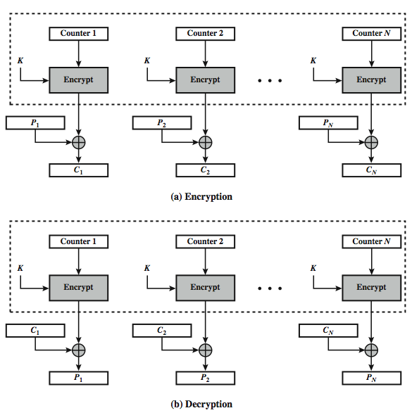
Counter (CTR)
Notes:
Stallings Figure 6.7 illustrates the Counter (CTR) Mode.

Slide 29
Advantages and Limitations of CTR
efficiency
  can do parallel encryptions in h/w or s/w
  can preprocess in advance of need
  good for bursty high speed links
random access to encrypted data blocks
provable security (good as other modes)
never have cycle less than 2^{b}
but must ensure never reuse key/counter values, otherwise could break (cf OFB)
Notes:
CTR mode has a number of advantages in parallel h/w & s/w efficiency, can preprocess the output values in advance of needing to encrypt, can get random access to encrypted data blocks, and is simple. But like OFB have issue of not reusing the same key+counter value.

Slide 30
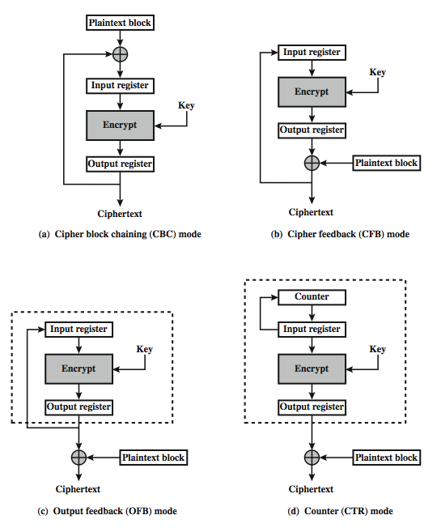
Feedback Character-istics
Notes:
Note that, with the exception of ECB, all of the NIST-approved block cipher modes of operation involve feedback. This is clearly seen in Stallings Figure 6.8. To highlight the feedback mechanism, it is useful to think of the encryption function as taking input from a input register whose length equals the encryption block length and with output stored in an output register. The input register is updated one block at a time by the feedback mechanism. After each update, the encryption algorithm is executed, producing a result in the output register. Meanwhile, a block of plaintext is accessed. Note that both OFB and CTR produce output that is independent of both the plaintext and the ciphertext. Thus, they are natural candidates for stream ciphers that encrypt plaintext by XOR one full block at a time.

Slide 31
XTS-AES Mode
need mode for block oriented storage
  No extra room in sector – data only
  Disk addressed by sector number
  Encryption can only take key externally
  Encryption can also use sector#, block#
Access to any sector should be independent of other sectors
Must prevent attack that copies sector to unused sector, then requests decryption
Notes:
NIST is currently in the process of approving an additional block cipher mode of operation, XTS-AES. This mode is also an IEEE standard, IEEE Std 1619-2007, which describes a method of encryption for data stored in sector-based devices. The XTS-AES mode is based on the concept of a tweakable block cipher. The requirements for encrypting stored data, also referred to as "data at rest" differ somewhat from those for transmitted data (see text for list). Encryption of a single block involves two instances of the AES algorithm with two keys, and a number of parameters (see text). In essence, the parameter j is the block number within the sector, and i is the 128-bit tweak for the sector. Each data unit (sector) is assigned a tweak value that is a nonnegative integer. The tweak values are assigned consecutively, starting from an arbitrary nonnegative integer.
The plaintext of a sector or data unit is organized in to blocks of 128 bits, hence the input to the XTS-AES algorithm consists of m 128-bit blocks and possibly a final partial block. For encryption and decryption, each block is treated independently and encrypted. The only exception occurs when the last block has less than 128 bits. In that case, the last two blocks are encrypted/decrypted using a ciphertext- stealing technique instead of padding.

Slide 32
XTS-AES Mode
new mode, for block oriented storage use
  in IEEE Std 1619-2007
concept of tweakable block cipher
different requirements to transmitted data
uses AES twice for each block
  T_{j} = E_{K2}(i) XOR α^{j}
  C_{j} = E_{K1}(P_{j} XOR T_{j}) XOR T_{j}
  where i is tweak & j is sector no
each sector may have multiple blocks
Notes:
NIST is currently in the process of approving an additional block cipher mode of operation, XTS-AES. This mode is also an IEEE standard, IEEE Std 1619-2007, which describes a method of encryption for data stored in sector-based devices. The XTS-AES mode is based on the concept of a tweakable block cipher. The requirements for encrypting stored data, also referred to as "data at rest" differ somewhat from those for transmitted data (see text for list). Encryption of a single block involves two instances of the AES algorithm with two keys, and a number of parameters (see text). In essence, the parameter j is the block number within the sector, and i is the 128-bit tweak for the sector. Each data unit (sector) is assigned a tweak value that is a nonnegative integer. The tweak values are assigned consecutively, starting from an arbitrary nonnegative integer.
The plaintext of a sector or data unit is organized in to blocks of 128 bits, hence the input to the XTS-AES algorithm consists of m 128-bit blocks and possibly a final partial block. For encryption and decryption, each block is treated independently and encrypted. The only exception occurs when the last block has less than 128 bits. In that case, the last two blocks are encrypted/decrypted using a ciphertext- stealing technique instead of padding.

Slide 33
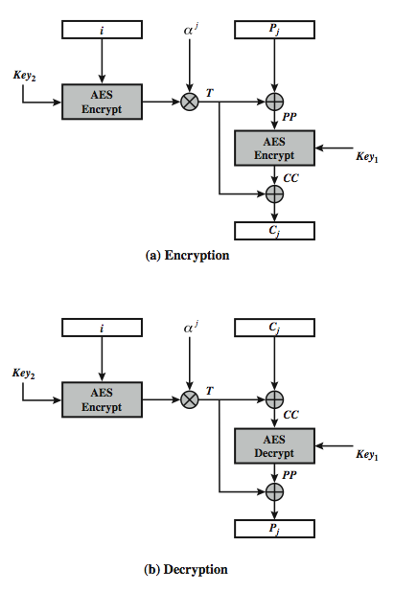
XTS-AES Mode
per block
Key whitening applied by XOR
With “tweak” that depends on
- sector
- block
- second key
Makes attacks more difficult
Makes operations depend on
data location
Notes:
Stallings Figure 6.9 illustrates the operation of the XTS-AES mode on a single block.

Slide 34
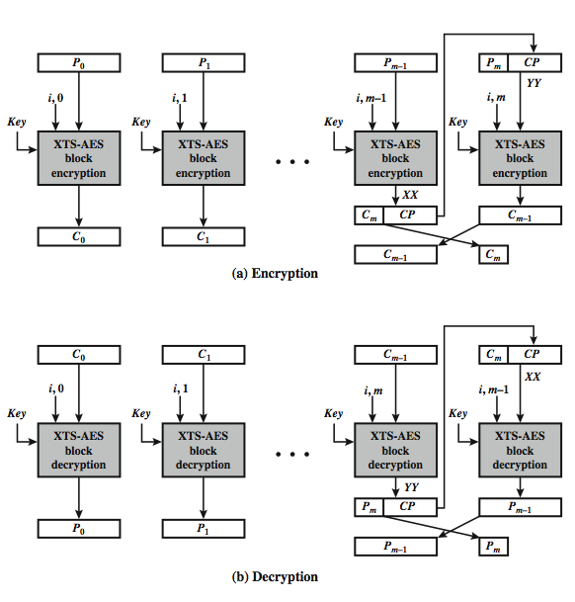
XTS-AES
Mode
Overview
Notes:
Stallings Figure 6.10 illustrates the ciphertext- stealing technique used in XTS-AES. This ensures that the encrypted data remains the same size as the original plaintext, which it must to fit on a block-oriented storage device. See text for more details.

Slide 35
Advantages and Limitations of XTS-AES
efficiency
  can do parallel encryptions in h/w or s/w
  random access to encrypted data blocks
has both nonce & counter
addresses security concerns related to stored data
Notes:
XTS-AES mode, like CTR mode, is suitable for parallel operation: because there is no chaining, multiple blocks can be encrypted or decrypted simultaneously. Unlike CTR mode, XTS-AES mode includes a nonce (the parameter i) as well as a counter (parameter j).

Slide 36
Summary
Multiple Encryption & Triple-DES
Modes of Operation
  ECB, CBC, CFB, OFB, CTR, XTS-AES
Next – Stream ciphers (Ch 7), then hash functions (Ch 11)
Notes:
Chapter 6 summary.

